Slide 1
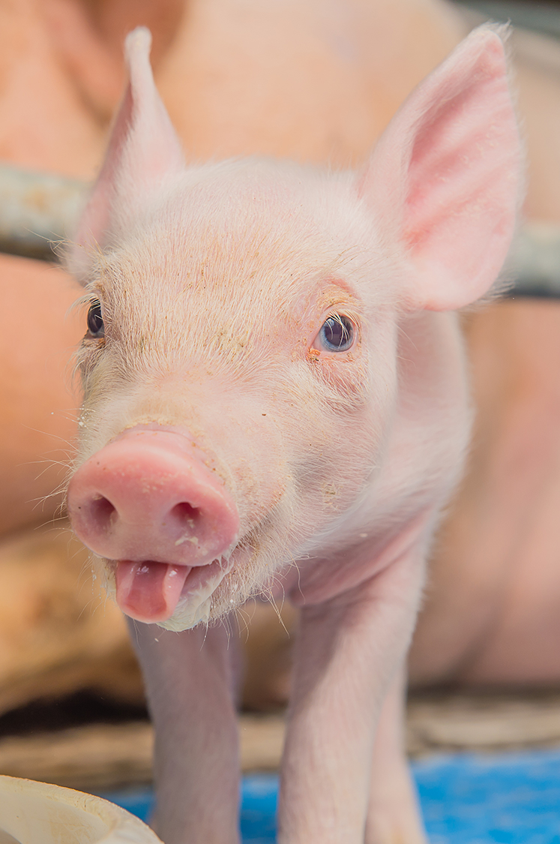
Pigs
My presentation is about …
Your name
Class

Slide 2
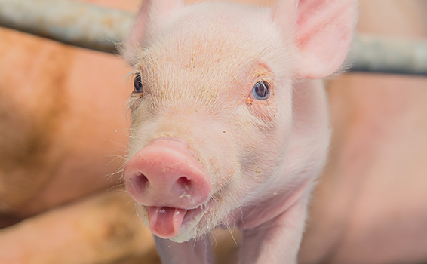
Introduction
What are you going to talk about….
Caption

Slide 3
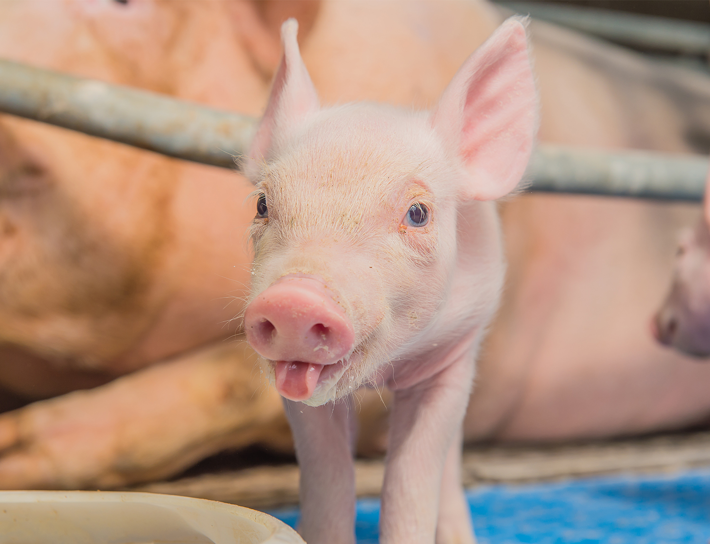
Caption photo

Slide 4
Quiz

Slide 5
Quiz

Slide 6
Question 1
Write your question here…
What is the answer?

Slide 7
Question 1
Write your question here…
What is the answer?

Slide 8
This is the end of my presentation
The end!

